Slide 1
SUCCESS in SCHOOL: What Does your Child’s Teacher Need to Know?
Ensuring School Success During and After a Cancer Diagnosis

Slide 2
PRESENTERS: Rachel Elliott, BSc, MEd Joanne Kutchyera, BEd, MEd

Slide 3
What is Today’s Focus?
How to communicate effectively with your child’s school
What information should be shared: what does the teacher need to know
What does your child need to be successful in school
What to realistically expect from the school
Notes:
Teachers WANT kids to do well in school
Teachers KNOW that families have a lot of information to share that can help teachers support the children beter

Slide 4
A Good Relationship
Begins With
Good Communication
Notes:
-developing a relationship with the teacher makes communicating much easier
-the best relationship with school staff is a PARTNERSHIP
-consider yourself as part of the child’s team at school, just as you do with your child's medical team

Slide 6
What about the “A” word?
Advocacy
Notes:
Some of you might have thought this presentation was all about advocacy
How is advocacy related to Communication and Relationship

Slide 7
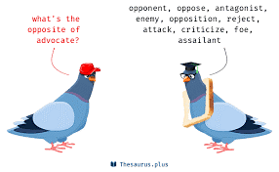

Slide 8
Advocacy is Not Adversarial
It is hard for people to help you if they are feeling attacked
Notes:
you can – MUST – be a voice for your child
how do you do this effectively?
Build on relationship
Book time to speak with the teacher or team – information on the fly information sharing is not ideal
Be prepared – with information about the child; with questions for the team
Know it is okay to have concerns and to speak to the concerns
Don’t be afraid to show emotion – you are speaking about your child after all
BUT – be respectful
DON’T assume this is a fight, don’t lash out, don’t make it accusatory or personal
It is hard for people to help you if they are feeling attacked

Slide 9
Medical Considerations Diagnostic Stage
“Research has shown that open communication between the school, parents and child with cancer can lessen the effects of cancer on a child’s education”
Canadian Cancer Society
Notes:
Inform the school about the DX ASAP
Provide details of treatment and timelines if known
Will the child be missing days, weeks or months of school?
Commit to keeping the teacher informed- keep connection to the school open
Off to have the KCC presentation “Cancer in the school to help classmates understand and to allay any fears they may have
Information takes the mystery and fear of the unknown out of the mind for both the teaching team and the classmated

Slide 10
Medical Considerations Post Treatment and Return to School Stage
When teachers know what the child is going through they can do a better job of supporting your child.
Notes:
Start planning early to create a re-entry plan
Meet with the school
Perhaps arrange a classroom visit with the child to re-familiarize him/her to the room and school
Provide details of the child’s “new normal” - general health status
Emphasize that your child wants to be treated as normally as possible

Slide 11
What to tell the School
Medications
Special devices and accomodations
Emergency management
Contact information
Special precautions
Physical considerations

Slide 12
Emotional Considerations
Return to School Stage
Share concerns and worries
Notes:
Let the teacher know how the child is feeling about return to school so she/he can appropriately respond and welcome the child into the classroom
Share child’s anxiety and concerns specifically

Slide 13
Academic Considerations
Return to School Stage
IPP
Academic Assessments
Changes/Setbacks
Focus
Align
Notes:
Your child will now likely be a candidate for an IPP which can cover medical, behavioural and academic considerations.
Provide teacher with any assessments that may have been done – ie Neuropsychological Assessment – as soon as you have a report. Then meet with teacher or team to:
Discuss changes that may be evident in child’s learning capacity, learning style or behaviours
Review any recommendations that have been included in the report
Discuss what is reasonable and possible for the school to provide
Focus on what the child truly needs to successfully re-enter school routines and learning

Slide 14
Developing an IPP
Return to School Stage
Collaborative
Strength-based
Focus on skills
Strategy development
Independence
Notes:
Your child will now likely be a candidate for an IPP which can cover medical, behavioural and academic considerations.
Provide teacher with any assessments that may have been done – ie Neuropsychological Assessment – as soon as you have a report. Then meet with teacher or team to:
Discuss changes that may be evident in child’s learning capacity, learning style or behaviours
Review any recommendations that have been included in the report
Discuss what is reasonable and possible for the school to provide
Focus on what the child truly needs to successfully re-enter school routines and learning

Slide 15
Notes:
Focus on what the child truly needs to successfully re-enter school routines and learning

Slide 16
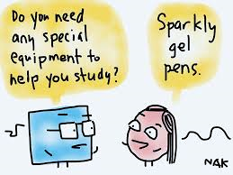

Slide 17
Notes:
Resources – always a factor
Fostering independence versus creating dependence

Slide 18
School Support Roles
Teacher
Resource Teacher
Educational Assistant
Support Staff
Administration
Paraprofessionals

Slide 19
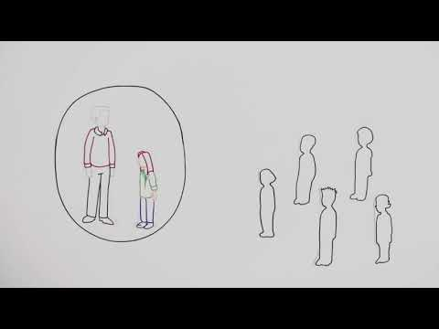
The Role of an Educational Assistant

